Slide 1


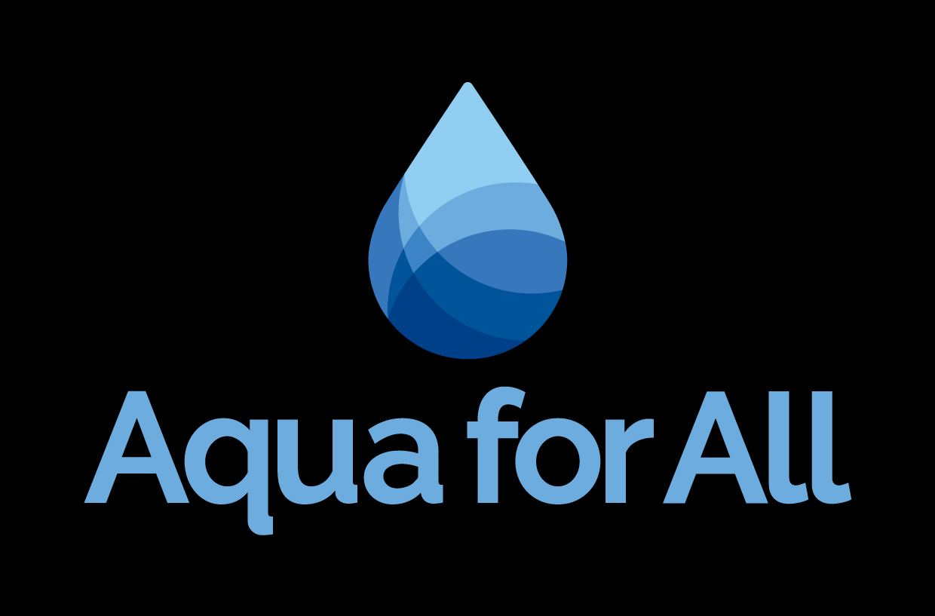
Global Water Investment Facility
A trajectory for financing water solutions in 100 priority basins
April-May 2026
Confidential

Slide 2
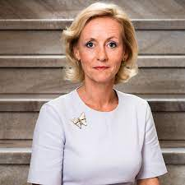
Dear [name],
Aqua for All is pleased to submit this proposal for catalytic capital from the [programme] at this critical juncture to transition our Global Water Investment Facility from concept to an investable design. In a strategic partnership with the CEO Water Mandate Water Resilience Coalition, we have already secured commitments from the Governments of the Netherlands and Luxembourg to establish a structured global water investment facility. Our global vehicle has a target size of [USD 1.5 billion] with an expected first close of [USD 250 million by Q4 2026]. To broaden our investment strategy and tailor it specifically to address water related adaptation and resilience in the Africa region we are looking to establish a dedicated sleeve for which we request your support.
This landmark initiative continues to position Aqua for All as a frontrunner in water and sanitation financing, advancing innovative public–private partnerships to strengthen global water resilience, paving the way for others to replicate and scale the model.
We believe we are well positioned to set-up and lead this investment vehicle and achieve significant impact in Africa. Key strengths of our proposal include:
Adaptation & Resilience in Africa: The facility will attract corporate investments to deliver measurable climate and social impact, strengthening water security and resilience in regions where climate change could cost up to 20% of GDP by 2050.
Private Capital Mobilization: Through the CEO Water Mandate’s Water Resilience Coalition, corporate commitments are translated into bankable projects, unlocking up to USD 1.5 billion in private capital and leveraging stewardship into large‑scale investment flows. Through your support, we can scale efforts in Africa targeting a leverage ratio of at least 1:4.
Experienced Investment Management: Aqua for All, a frontrunner in water and sanitation financing, leads with proven fund structuring expertise, supported by a robust governance framework and seasoned partners to ensure disciplined execution and impact delivery.
This document comprises our high-level proposal for your consideration, and we remain available to answer any queries you may have.
Josien Sluijs
Managing Director
M: +31625036924
j.sluijs@aquaforall.org
The Hague, [date] 2026

Slide 3
Executive summary
Text
Extra information
Text

Slide 4
Executive summary
Text
Extra information
Text

Slide 5
Executive summary
Text
Extra information
Text

Slide 6

Contents
1.
Vision
2.
Context
3.
Aqua for All and Water Resilience Coalition
4.
A Global Water Investment Facility
5.
Targeted Portfolio
6.
Impact
7.
Governance
8.
Call to Action & Next Steps
9.
Annex: Structure and Terms

Slide 7

Vision
A COLLECTIVE CHALLENGE
A SHARED GOAL
A JOINT OPPORTUNITY
The Global Water Financing Challenge
Global funding gap
Limited private investments
Cost of inaction
Invest $2B
in WASH, reaching 100 million people by 2027 and 300 million people by 2030.
The Global Water Investment Facility
Scalable solution
Unlocking economic value
Impact results
Our 2030 Ambition: Positive Water Impact in 100 Priority Basins

Slide 8
Vision and Ambition
A COLLECTIVE CHALLENGE
A SHARED GOAL
A JOINT OPPORTUNITY
AMBITION
The Global Water Financing Challenge
Global funding gap
Limited private investments
Cost of inaction
Invest $2B
in WASH, reaching 100 million people by 2027 and 300 million people by 2030.
The Global Water Investment Facility
Scalable solution
Unlocking economic value
Impact results
Our 2030 Ambition
Positive Water Impact in 100 Priority Basins
[Name Stichting], in partnership with the CEO Water Mandate’s Water Resilience Coalition (WRC), is addressing the global water financing challenge by combining corporate leadership and basin-level priorities with Aqua for All’s expertise in water investments and fund structuring.
The objective of this initiative is to establish a Global Water Investment Facility with the ambition to invest corporate capital for positive water impact in the value chains of 100+ water-stressed basins, reaching 100 million people by 2027 and 300 million people by 2030. Our global vehicle has a target size of USD 1.5 billion with an expected first close of USD 175 million by Q4 2026.
The focus of the facility is on the one side to attract corporate investors into the Global Water Investment Facility, deploying its capital into funds that enable private sector projects focused on water infrastructure, natural capital, financial institutions and enterprises that have the goal to respond to and reduce water risks within assets, companies and their value chains. They are also expected to result in significant climate adaptation and resilience solutions, gender empowerment and economic development opportunities.
The set-up of the facility is supported by the Governments of the Netherlands and Luxemburg.

Slide 9
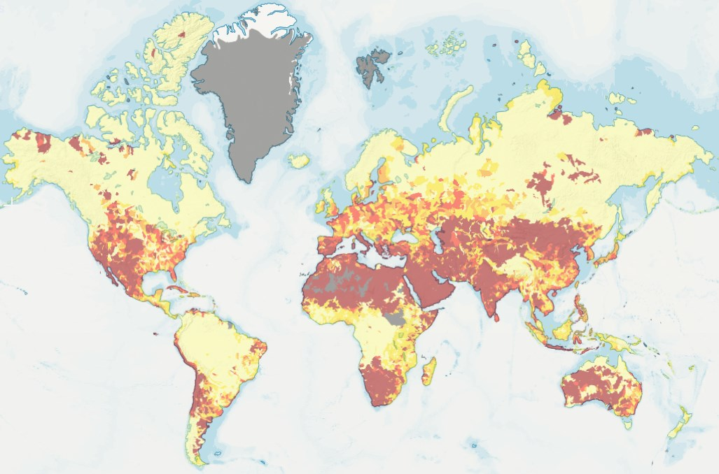
Context
Global spending on water is insufficient
To meet 2030 SDGs for universal access to safe water and sanitation, > US$1 trillion per year is needed to deliver sustainable water management globally.
(World Bank 2026)
Public spending (0.5% of GDP on average) constitutes the largest share of spending in the water sector. Private spending makes up roughly 2%.
(World Bank 2026)
The cost of inaction on water risk is
5x higher
than the cost of investment.
Why this matters
$300B+ in potential business losses from unmitigated water risks.
(CDP Water Analysis Report 2020)
Hidden costs of water are often >3x the price paid on utility bills.
(AnteaGroup Determine True Cost of Water 2025)
$200B annual insurance losses from water-driven events projected by 2034.
(WEF Water Futures: Mobilizing Multi-Stakeholder Action for Resilience 2025)

Slide 10
Context
Global spending on water is insufficient
To meet 2030 SDGs for universal access to safe water and sanitation, > US$1 trillion per year is needed to deliver sustainable water management globally.
(World Bank 2026)
Public spending (0.5% of GDP on average) constitutes the largest share of spending in the water sector. Private spending makes up roughly 2%.
(World Bank 2026)
Why this matters
$300B+ in potential business losses from unmitigated water risks.
(CDP Water Analysis Report 2020)
Hidden costs of water are often >3x the price paid on utility bills.
(AnteaGroup Determine True Cost of Water 2025)
$200B annual insurance losses from water-driven events projected by 2034.
(WEF Water Futures: Mobilizing Multi-Stakeholder Action for Resilience 2025)
The cost of inaction on water risk is
5x higher
than the cost of investment.

Slide 11
Macro Trends
Investing in water protects value chains from water stress and increases predictable operations alongside impact returns
The cost of inaction on water risk is
5x higher
than the cost of investment.
In 2050, 46% of global GDP will come from regions with high water risk. Climate change exacerbates these risks and directly impacts availability of freshwater. Across the globe, rivers are running dry, aquifers are shrinking. Business and their value chains are dependent on products from agriculture (e.g. food production), freshwater resources as inputs (e.g. beverage companies), and using water for their processes (e.g. data centers). Water stress caused by climate change leads to increased costs, production interruptions and market instability.
The WRC has identified the 100 Priority Basins where climate change, water stress, business risk, and social need intersect and where collective action is most urgent and impactful. These basins support communities with access to clean water and sanitation services, local economies, and farms facing supply chain disruptions.
Each priority basin represents an area of:
High water risk where scarcity or pollution threatens both communities and economies.
Shared responsibility where no stakeholder can make a difference alone.
Opportunities for resilience where solutions exist and can be scaled for positive impact.
Adaptation
In a world where usable water will become scarcer due to climate change, adaptation is essential. Through investing in better water management of key water basins, sustainable water use in value chains, water treatment, and provision of safe water and sanitation to communities.
Resilience
Additionally, sudden and slow onset climate events are posing a risks to businesses and their value chains. Making their operations resilient to changing environmental conditions is essential.

Slide 12
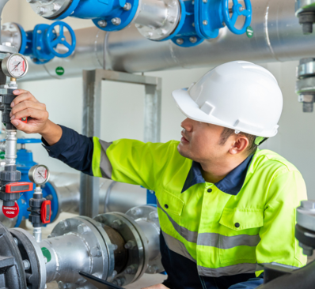
Investors invest in markets, then projects
Water as an investment opportunity
Considering the magnitude of the problem we need to work on systemic solutions in addition to repairing leaking water pipes.
Shift in focus: Water investment is moving beyond traditional WASH solutions toward integrated approaches that deliver combined economic, social, and climate benefits.
Beyond operations: Investments extend past core business premises to catalyze solutions across nexus sectors — water, food, energy, industry, and circular economy. This positions companies not only as resilient operators but also as drivers of systemic transformation.
Opportunity: This creates a larger pool of transformative solutions that address global market failures while contributing to a water‑resilient future.
Guiding Principles
Anchored in core and beyond: Strengthen resilience within operations while scaling nexus solutions with systemic impact.
Transformational: Unlock financial and economic value through strategic private‑sector water investments.
Commercially viable: Ensure investments preserve economic capital and minimize expected losses.
Selective / Additional: Target market gaps, starting with the challenge and integrating ESG and impact assessments aligned with global standards.
Speed: Urgency demands rapid execution. Aggregation and programmatic approaches accelerate deployment.
Partnerships: Collaboration is essential. We engage leaders and stakeholders across the resilient water finance space.

Slide 13
Core Investment Thesis
Water as an investment opportunity that leverages impact
Investment Opportunity
Essential asset class: Water is a non-substitutable resource underpinning all economies, making it a resilient long-term investment. Water is integral to over 60% of global gross domestic product (GDP).
Growing demand–supply gap: Rising urbanization, industrialization, and climate stress create structural scarcity, driving value in water efficiency, reuse, and infrastructure. By 2030 water demand is expected to outstrip supply by 40%.
Blended finance opportunity: To meet SDG commitments, the world needs to mobilize up to USD 7 trillion by 2030 for global water infrastructure. Public–private partnerships and concessional capital can de-risk investments, unlocking private flows into water resilience projects.
Technology & innovation: Groundwater is being withdrawn at a rate 3.5 times faster than it is able to replenish itself in some major aquifers. Digital monitoring, desalination, and circular water systems offer scalable solutions with strong commercial potential.
Policy & regulation tailwinds: Global commitments (SDGs, Paris Agreement, corporate water disclosure frameworks) are pushing capital toward water-positive investments.
Sustainability and Impact Linkages
Sustainability and reliability: Investments in water resilience contribute to sustainable and reliable supply systems and reduces vulnerability to droughts, floods, and climate shocks, protecting the business operations as well as communities and ecosystems.
Economic productivity: Efficient water use in e.g. agriculture and industry boosts yields and competitiveness while lowering environmental footprints.
Improving water quality: Treatment of agricultural and industrial wastewater, as well as domestic sewage, through the application of new technologies where applicable, improves water quality and leads to expanding safe water access.
Monetisation of valuable waste streams: Liquid and solid waste, recycling of plastics can lead to cost reductions.
Biodiversity protection: Restoring watersheds and reducing pollution safeguards habitats, aligning with nature-positive investment strategies.
ESG & corporate value: Strong water stewardship enhances reputational capital, meets investor ESG and sustainability criteria, and drives long-term shareholder value.
Source: Global Commission on the Economics of Water; WWF; Kumar, M., Jangam, C. L., & Singh, S. K.; The World Bank; Guo, Y., et al..

Slide 14
Market Size
Insert figure / diagrams.
Water investments beyond direct project investments and on the nexus with other sectors are required to enable transformative solutions
Global water-related economy
The estimated revenues of the global water related economy are USD x. This consists of 1) all economic handling activities in which water is a major process input (USD x), 2) all economic activities that depend on water (USD x), 3) water related equipment and services (USD x) and 4) water treatment and distribution (USD x).
Financing opportunities in priority sectors
In addition to the water sector itself, priority sectors that are heavily dependent on water include, but are not limited to consumer goods, textiles, agriculture and tech.
Financing opportunities in priority themes
Text (preferably include numbers). Infrastructure, nature based solutions, financial institutions (WASH portfolio), SMEs and ventures.
Financing opportunities in priority basins
Text (preferably include numbers)

Slide 15
Market Size
Insert figure / diagrams.
Water investments beyond direct project investments and on the nexus with other sectors are required to enable transformative solutions
Global water-related economy
The estimated revenues of the global water related economy are USD x. This consists of 1) all economic handling activities in which water is a major process input (USD x), 2) all economic activities that depend on water (USD x), 3) water related equipment and services (USD x) and 4) water treatment and distribution (USD x).
Financing opportunities in priority sectors
In addition to the water sector itself, priority sectors that are heavily dependent on water include, but are not limited to consumer goods, textiles, agriculture and tech.
Financing opportunities in priority themes
Text (preferably include numbers). Infrastructure, nature based solutions, financial institutions (WASH portfolio), SMEs and ventures.
Financing opportunities in priority basins
Text (preferably include numbers)

Slide 16
Market Size
Insert figure / diagrams.
Water investments beyond direct project investments and on the nexus with other sectors are required to enable transformative solutions
Global water-related economy
The estimated revenues of the global water related economy are USD x. This consists of 1) all economic handling activities in which water is a major process input (USD x), 2) all economic activities that depend on water (USD x), 3) water related equipment and services (USD x) and 4) water treatment and distribution (USD x).
Financing opportunities in priority sectors
In addition to the water sector itself, priority sectors that are heavily dependent on water include, but are not limited to consumer goods, textiles, agriculture and tech.
Financing opportunities in priority themes
Text (preferably include numbers). Infrastructure, nature based solutions, financial institutions (WASH portfolio), SMEs and ventures.
Financing opportunities in priority basins
Text (preferably include numbers)

Slide 17
Investment Opportunity
Access to water as an investable asset class, investable opportunities found in every sector – a snapshot
Sector | Investment opportunities / Business models | Financial viability | Impact potential | Link with fund portfolios
Consumer Goods | Circular packaging Refill and reuse models Water-efficient manufacturing processes | Cost savings from reduced water and energy use | Reduced water abstraction and wastewater discharge Lower plastic leakage into waterways | Circular economy and impact consumer goods
Textiles | Low-water dyeing; wastewater recycling and treatment Sustainable fiber production | Reduced treatment costs Improved resilience to water scarcity | Reduction in water pollution Improved water basin health | Sustainable apparel Industrial water treatment
Agriculture | Precision irrigation Soil moisture sensing Climate smart inputs Water-efficient post-harvest solutions | Higher yields and input efficiency Reduced water and energy costs | Reduced water withdrawals Improved groundwater recharge Lower nutrient runoff | Agri-tech Climate-smart agriculture and food systems
Water | Utility partnerships through service contracts/co-investment Fecal sludge management | Reduced capex Operational cost efficiencies | Improved water quality Reduced groundwater/ surface water contamination | WASH-focused investment vehicles Infrastructure and utility investments
Tech | Water-efficient cooling Rainwater capture AI driven water management | Reduced operational costs Lower risk of supply disruptions | Improved water resilience Minimized freshwater use | Climate-resilient infrastructure Water stewardship-linked investments

Slide 18
Investment Opportunity
Access to water as an investable asset class, investable opportunities found in every sector – a snapshot
Sector | Investment opportunities / Business models | Financial viability | Impact potential | Link with fund portfolios
Consumer Goods | Circular packaging Refill and reuse models Water-efficient manufacturing processes | Cost savings from reduced water and energy use | Reduced water abstraction and wastewater discharge Lower plastic leakage into waterways | Circular economy and impact consumer goods
Textiles | Low-water dyeing; wastewater recycling and treatment Sustainable fiber production | Reduced treatment costs Improved resilience to water scarcity | Reduction in water pollution Improved water basin health | Sustainable apparel Industrial water treatment
Agriculture | Precision irrigation Soil moisture sensing Climate smart inputs Water-efficient post-harvest solutions | Higher yields and input efficiency Reduced water and energy costs | Reduced water withdrawals Improved groundwater recharge Lower nutrient runoff | Agri-tech Climate-smart agriculture and food systems
Water | Utility partnerships through service contracts/co-investment Fecal sludge management | Reduced capex Operational cost efficiencies | Improved water quality Reduced groundwater/ surface water contamination | WASH-focused investment vehicles Infrastructure and utility investments
Tech | Water-efficient cooling Rainwater capture AI driven water management | Reduced operational costs Lower risk of supply disruptions | Improved water resilience Minimized freshwater use | Climate-resilient infrastructure Water stewardship-linked investments

Slide 19

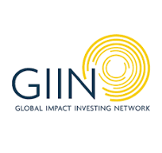

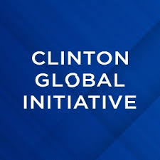
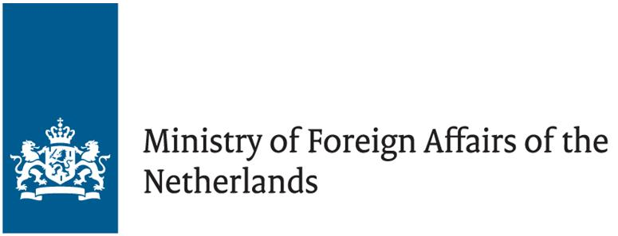


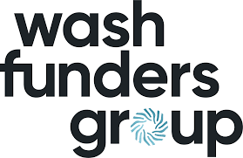

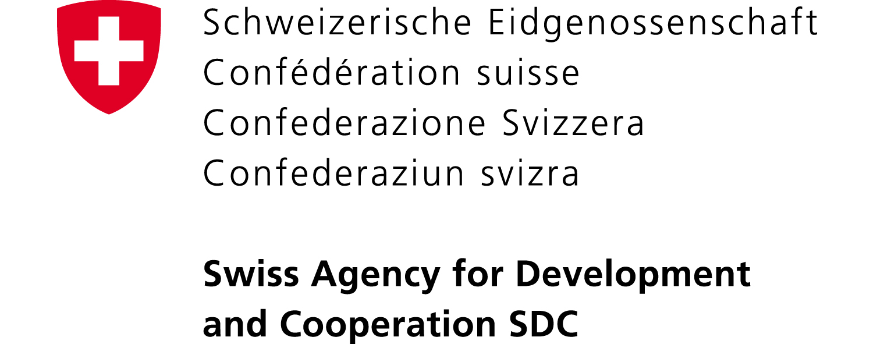
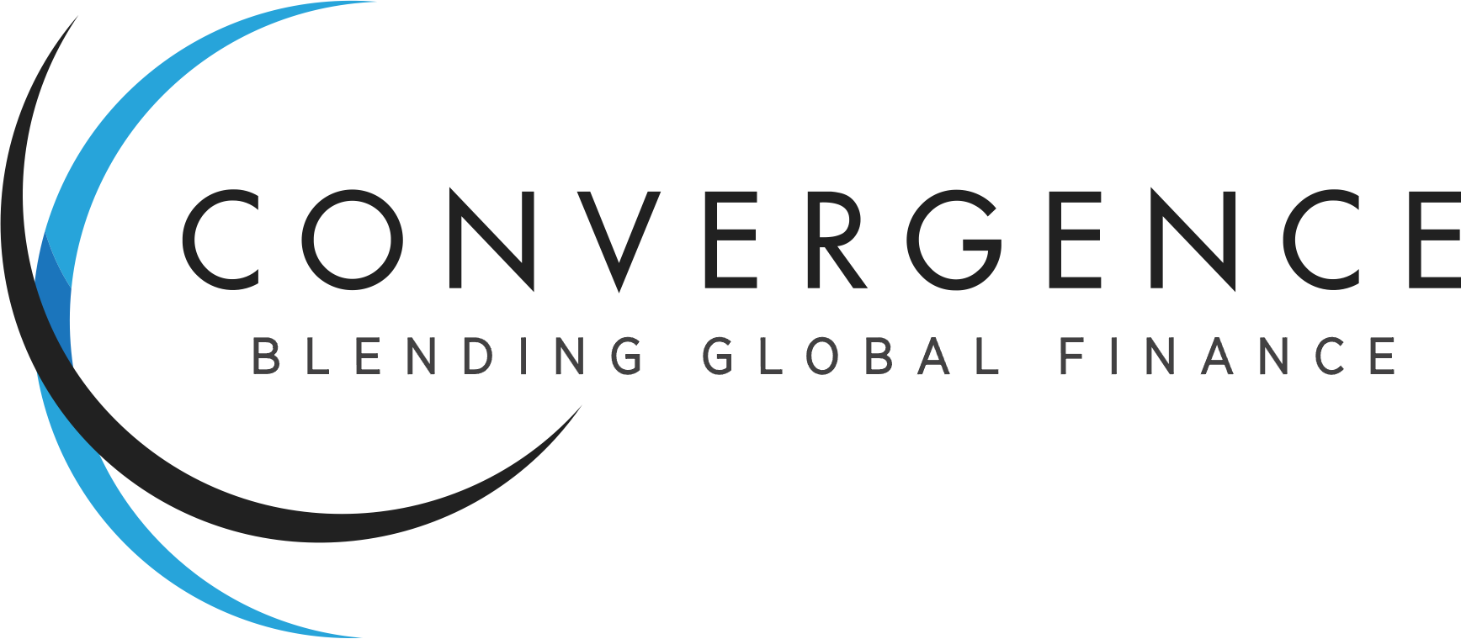
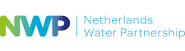

A trusted international partner
Fund investments
Market development
Country
specific
expertise
Global
funder base
Assets since 2002
€271 million
> €100 million
in mandates​ managed from public investors
and corporate foundations
*Including grants and leverage
Results since 2019
10 million people
reached
7x
capital leveraged
935 enterprises
supported
Selection of key partners
Influential in the sector

Slide 20
Title
About the CEO Water Mandate Water Resilience Coalition
The Water Resilience Coalition (WRC) is an industry-driven, CEO-led initiative to address the global water crisis. It is an initiative of the CEO Water Mandate between the UN Global Compact and the Pacific Institute.
WRC’s aim is to elevate action on mounting water stress and its connection to climate change to the top of the global corporate agenda.
WRC members work to preserve the world’s freshwater resources through collective action in water-stressed basins and through ambitious, quantifiable goals.
Extra information
Text

Slide 21


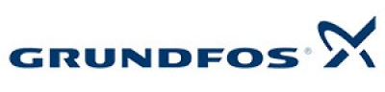
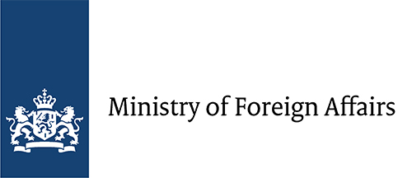



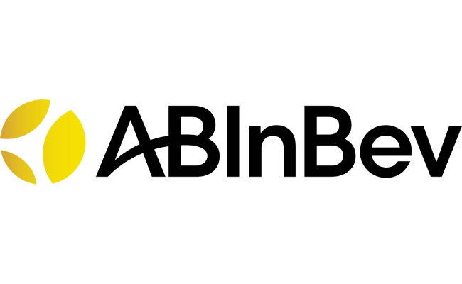


Title
Committed public funders
Selection of interested partners
Selection of corporate frontrunners

Slide 22
Title
Committed public funders
Selection of interested partners
Selection of corporate frontrunners

Slide 23

How it works: Global Water Investment Facility
A bespoke investment facility where the capital flows from corporate investments to project realization
Corporate Investors
Fund management
Funds
Private sector projects
1
1
Global
Water Investment Facility
2
2
Private equity
Fund participations
Equity investment
Private debt
3
3
4
4
Reduced water risks within assets, companies and their value chains.

Slide 24
Key benefits
Impact opportunities in value chain and at end-user level, beyond direct operations.
Portfolio diversification across geographies, sectors and projects.
Access to key strategic partners and networks with blended finance opportunities including de-risking lowering the cost of private capital.
Predictable returns and active access to and management of assets.
A systemic approach to transform the water financing sector.
Public sector support

Slide 25
Key benefits
Impact opportunities in value chain and at end-user level, beyond direct operations.
Portfolio diversification across geographies, sectors and projects.
Access to key strategic partners and networks with blended finance opportunities including de-risking lowering the cost of private capital.
Predictable returns and active access to and management of assets.
A systemic approach to transform the water financing sector.
Public sector support

Slide 26
Key benefits
Impact opportunities in value chain and at end-user level, beyond direct operations.
Portfolio diversification across geographies, sectors and projects.
Access to key strategic partners and networks with blended finance opportunities including de-risking lowering the cost of private capital.
Predictable returns and active access to and management of assets.
A systemic approach to transform the water financing sector.
Public sector support

Slide 27
Investing at Scale
Corporate investments in a risk-sharing structure
Pathway to achieving the overall $2B investment target
The overall goal of the Global Water Investment Facility is to invest USD 2 billion in water and sanitation management reaching 100 million people by 2027 and 300 million people by 2030.
Annual collective
Investment target ($M)
Corporate Engagement (#) | 10 | 15 | 20 | 35 | 50 | 50
Avg. investment per corporate | 16 | 12.7 | 12.5 | 11.4 | 10 | 10
1 NOTE:
*

Slide 28
How it works: Global Water Investment Facility
A bespoke investment facility where the capital flows from corporate investments to project realization
1
2
3
4
Key BENEFITS of
this structure
Broad geographic reach.
Impact opportunities in the value chain and at end-user level, in addition to direct operations.
Access to key strategic partners and networks with blended finance opportunities including de-risking to lower the cost of private capital.
Investment return opportunities and active access to and management of assets.
Contributes to a systemic approach to transform the water financing sector.
Corporate investors invest capital from their balance sheets …
… into the Global Water Investment Facility that manages the deployment of the investments …
… into pre-screened funds that are aligned with the WRC mission …
… supporting private sector projects focus on water infrastructure, natural capital, financial institutions (WASH portfolios), enterprises and ventures.
Corporate Investors
Fund management
Funds
Private sector projects
1
Global
Water Investment Facility
1
Private equity
2
Fund participations
Equity investment
2
Private debt
3
3
4
4
Reduced water risks within assets, companies and their value chains.

Slide 29
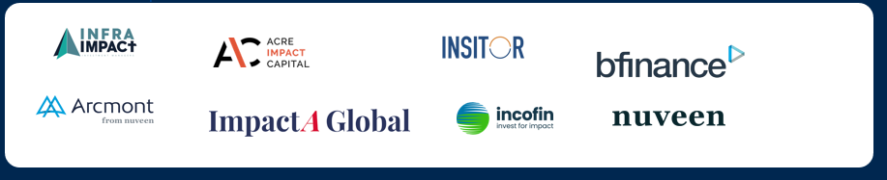
From Concept to Action
Pathway to achieving the overall USD 2 billion investment target – immediate next steps
Goal: USD 2B invested by 2030 across 100 priority basins.
Corporate Investors: Two WRC co-chairs each invest USD 50 million in the Global Water Investment Facility by December 2026. Six corporate frontrunner follow with investments of USD 12.5 million per corporate. At WEF 2027 a pledge of USD 175 million in the Global Corporate Investment Facility is announced.
Global Water Investment Facility: Target first close of the Global Corporate Investment Facility with an initial fund size of USD 175 million is January 2027.
[say something about government support? ]
Deployment in funds: In 2027, USD x million will be deployed in x funds that are aligned with the WRC mission. Investments will be ringfenced by geography / impact theme / sector.
Projects supported: Average ticket size of investments by funds in underlying project portfolio is x. In 2027 x projects will be supported. Targeted impact results include: x people reached, x water quality, x water availability.
  Investments with impact results plus financial return are prioritized.
Dec 2026
@ US$
50m
@ US$
12.5 m
Jan 2027
Global Water Investment Facility
Target first close @ US$ 175 m
2027
2027
PROJECT PORTFOLIO
GEOGRAPHY

Slide 30
Scaling Strategy
Both the Government of the Netherlands and the Government of Luxemburg have committed their support and seed capital to design and set-up the facility, working towards a first close end 2026.
The first corporate indicated willingness to invest USD 50 million by end 2026.
With the support of concessional funding and blended finance solutions, the facility will be set-up with dedicated sleeves to mobilize corporate investments in climate-resilient water management when market barriers and risks are considered too high. The foreseen blended capital structure, combines catalytic and private capital layers to accommodate different risk-return profiles.
Funder’s catalytic capital will absorb early-stage risks through subordinated equity such as first loss and junior equity while private investors will invest senior capital and will be offered market-rate returns. This structure is designed to attract private capital into high-impact, scalable climate-resilient water projects in diversified markets and sectors.
Corporate investments in a risk-sharing structure
Pathway to achieving the overall $2B investment target
The overall goal of the Global Water Investment Facility is to invest USD 2 billion in water and sanitation management reaching 100 million people by 2027 and 300 million people by 2030.
Annual collective
Investment target ($M)
Corporate Engagement (#) | 10 | 15 | 20 | 35 | 50 | 50
Avg. investment per corporate | 16 | 12.7 | 12.5 | 11.4 | 10 | 10
1 NOTE:
*

Slide 31
Capital Deployment Strategy

Slide 32

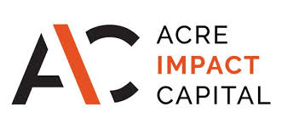
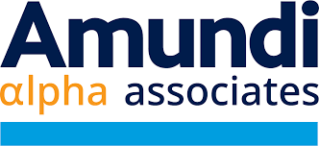
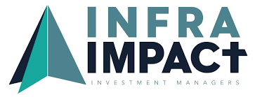
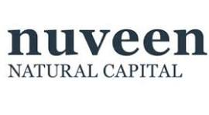
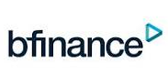

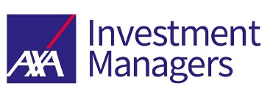



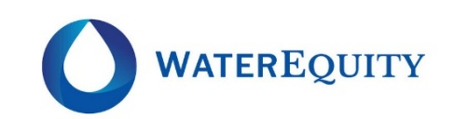
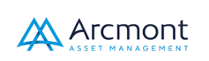
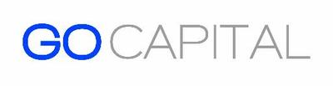


Investment Pipeline
Universe of private funds seeking over USD 7.3 billion in capital
Fund managers that reduce water value‑chain risks – a snapshot
Infrastructure
Infrastructure (10-12%)
Invest in essential infrastructure
Nature Based Solutions
Impact (5-10%)
Invest in measurable outcomes
Financial
Institutions
(WASH portfolio)
Private Credit
Direct financing to private business
Enterprises and Ventures
Private Equity
Invest in private companies

Slide 33
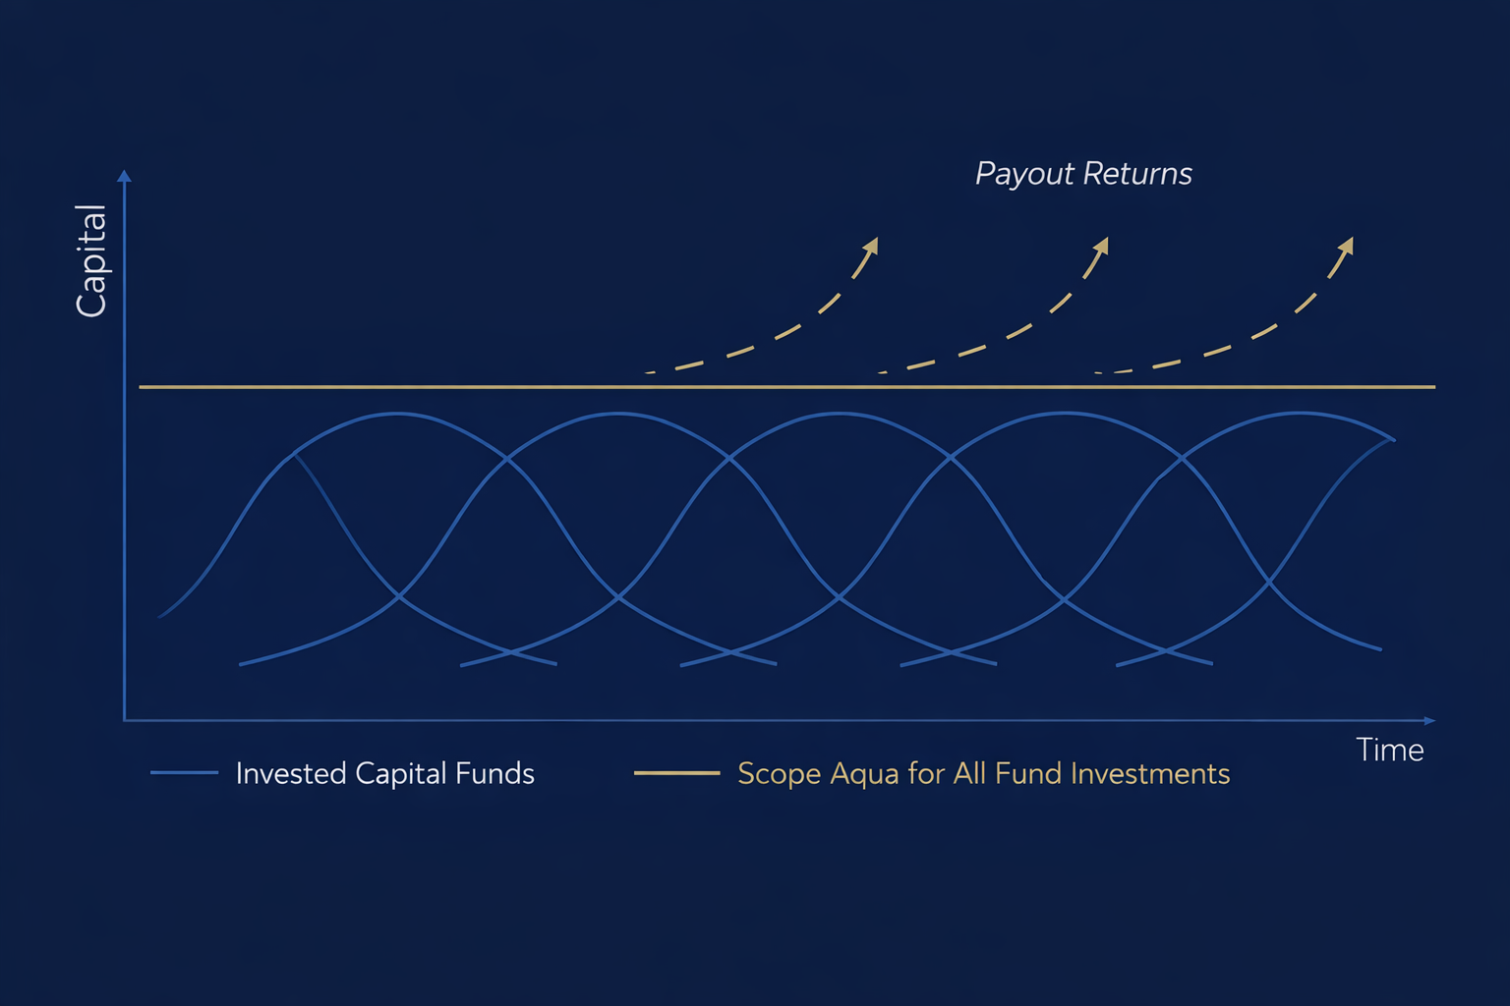
Value proposition for investors
Capital calls
Investor Value Proposition
Simple structure – one fund, fixed commitment
Limited capital calls
Access to multiple funds
Capital put at work immediately
Increased payout returns
Subscribe periodically
Redemption option
Perpetual life

Slide 34
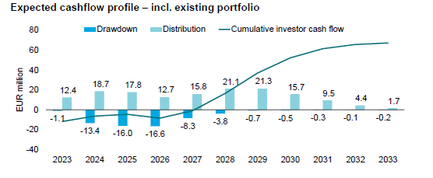
Value proposition for investors
J-curve cash flow
Benefits
Impact across the value chain – resilience beyond direct operations
Diversification – continents, sectors, strategies
Ease of administration – straightforward governance
Predictable cash flow profile – clear J‑curve with early drawdowns, rising distributions
De‑risked participation – blended finance lowers cost of capital
Strategic positioning – access to global partners and priority basins
Dual returns – measurable water/climate impact + financial performance
Two anchor investors each invest USD 50m by end 2026.
Six frontrunners each invest USD [12.5m] by end 2026.

Slide 35
Value proposition for investors
While delivering positive water impact
J-CURVE CASH FLOW
CAPITAL CALLS
Overall benefits
Impact across the value chain – resilience
Diversification – continents, sectors, strategies
Ease of administration – straightforward governance
Predictable cash flow profile
De‑risked participation – blended finance
Strategic positioning – priority basins
Dual returns – measurable water/climate impact + financial performance

Slide 36
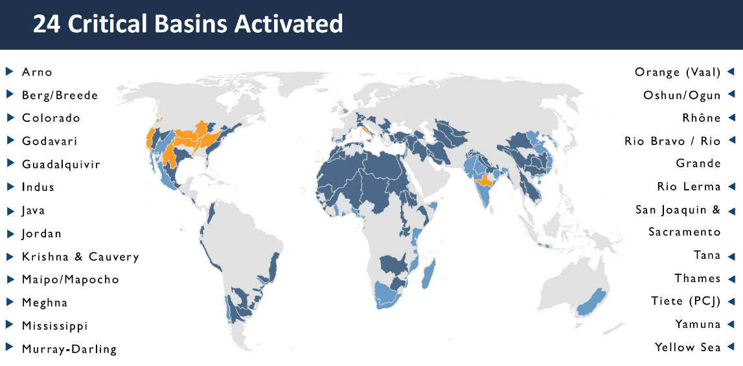
Targeted Geography, Sectors, Themes
Investing in priority water basin value chains
Geography
Focus on global north and global south. Global north presents increasing water stress, unequal water access, declining infrastructure. Technology and innovation hold the key for addressing issues of access, water sources recharge, quality and circular economy. Global south presents substantial addressable market and impact potential.
Sectors
Priority sectors include water infrastructure, consumer goods, textiles, agriculture, tech. Based on corporate priorities these sectors can be broadened.
Themes
Priority themes include – gerelateerd aan business sense
Targeted water basins and water basin value chains
Focus on priority sector value chains in the 24 priority basins. Enabling private sector projects focused on water infrastructure, natural capital, financial institutions and enterprises that have the goal to respond to and reduce water risks within assets, companies and their value chains.

Slide 37
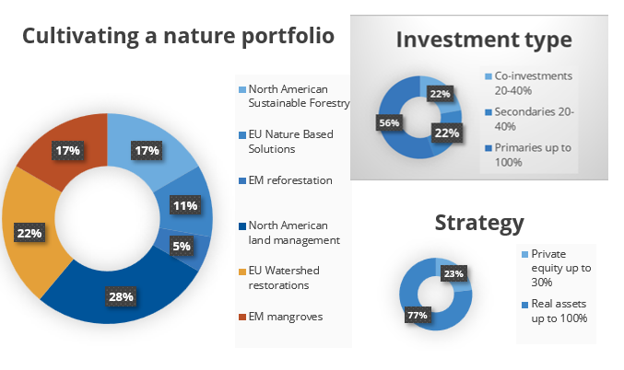




Sample diversified investments
For illustration purposes only
Focus themes (snapshot)
Infrastructure:
Utilities, water security, climate resilience, treatment and supply, infrastructure upgrading (tech solutions) and renewal, re-use.
  Natural capital:
  Land management, mangroves, water shed restorations.
  MFIs/FIs:
  Climate, gender, SDG aligned themes, ESG aligned, financial inclusion.
  SMEs innovations:
  Textile, agri, consumer goods, tech, venture.
Indicative terms (snapshot)
Capital Commitment: Minimum USD 12.5m
Fundraising Timeline: First close Dec 2026 (USD 150m); final close Dec 2028 (USD 1.5B).
Investment period: 10-12yr
Target IRR: 5%-8% net IRR

Slide 38
Investment Portfolio - Forecast
Sample diversified investments
Focus themes (snapshot)
Infrastructure:
Utilities, water security, climate resilience, treatment and supply, infrastructure upgrading (tech solutions) and renewal, re-use.
  Natural capital:
  Land management, mangroves, water shed restorations.
  MFIs/FIs:
  Climate, gender, SDG aligned themes, ESG aligned, financial inclusion.
  SMEs innovations:
  Textile, agri, consumer goods, tech, venture.

Slide 39
Investment Pipeline

Slide 40

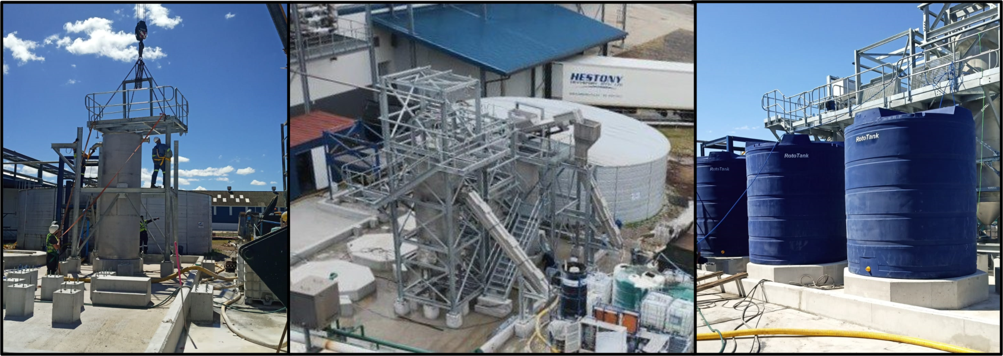
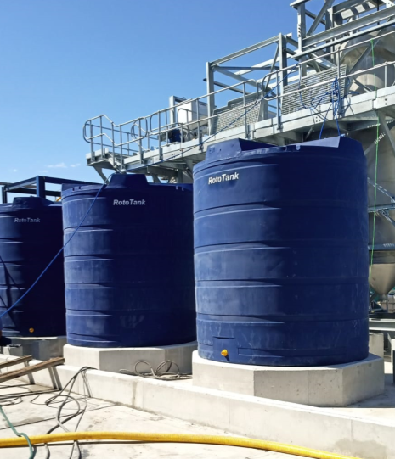
Fund investments example
Private equity fund for sustainable water infrastructure
Evenpar Fund I (EF-I)
Project close size: EUR 1-3 million (2024, 2025)
Investment Aqua for All: EUR 150k equity
Term: 5 years
IRR: 15%
Geographic focus: South-Africa
Investors: foundation, HNWIs, family offices
Impact:
First decentralized wastewater treatment project treats 190k liters per day
Second project treats 164 million liters p.a., solving a sewerage discharge problem

Slide 41
Investment Process

Slide 42
Impact

Slide 43







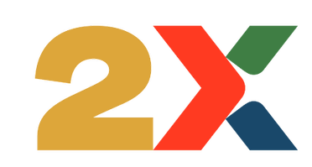




Sustainability & ESG - INDICATIVE
Our impact vision: Delivering on our impact targets in a financially sustainable manner while investing for long-term value creation
 | Key Performance Indicators (Indicative) Monitored over the life of the Vehicle | Year 1* | Yr N
1. | Total investments made (# and USD)
2. | Cumulative amounts mobilised (USD)
3. | Funds supported in target countries (#)
4. | Investments made classified as climate resilient (#)
5. | People reached with climate resilient water services (#), disaggregated by gender
6. | Improved water quantity and quality
7. | Increased water availability
8. | Companies who have conducted a (physical) climate risk assessment (#)
9. | Financial indicators, including Profitability, Portfolio outstanding, NPLs
10. | Number of investees that are 2X aligned
11. | Number of investments in Nature-based Solutions
* | Targets to be further refined based on capital structure
Our impact and ESG measurement and management system is a strategic opportunity to align with and contribute to achieving SDG 5, 6, 8, 13 and 17.
It allows us to identify and consider the positive and negative effects our business actions have on people and the planet, and then figuring out ways to mitigate the negative and maximize the positive in alignment with international best practice.​
We have an integrated approach to managing the impact of our investments, or portfolio of investments, which means we take into account the positive and negative impacts (aligned with the IFC Performance Standards) of the underlying companies/assets, as well as our own contributions.
Our impact and ESG systems are closely linked to our investment cycles and transaction process and includes five distinct actions:​
Set goals, screen and select the right transactions​.
Design climate aligned and gender equitable transactions.
Manage impact and ESG results and risks.
Collect data, monitor, report and manage impact performance based on which incentives kick-in.
Based on operational findings, we learn and adjust our approaches. ​
SDG Alignment
ESG Principles
Climate Standards
Impact Alignment

Slide 44
Impact Results - Forecast
Text
Text
Text
Text
Text
Text
Text
Text

Slide 45
Impact Results - Forecast
Text
Text
Text
Text
Text
Text
Text
Text

Slide 46
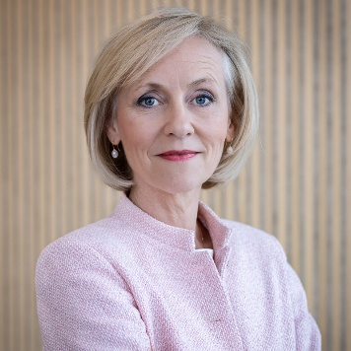
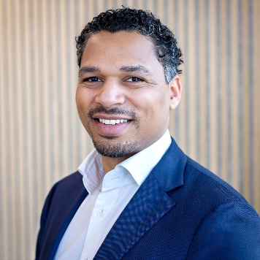
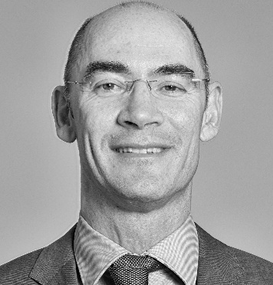
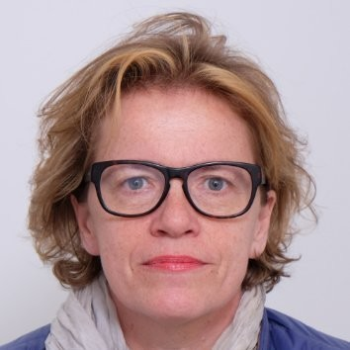
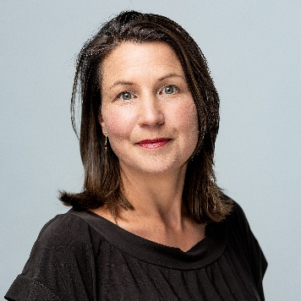
Key Team and Experts
An entrepreneurial, skilled, experienced and diverse team with local presence and a track record of mobilising capital at scale
Key people
Partner experts
Josien Sluijs
Managing Director
Aarno Keijzer
Investment Director
Mark van Doesburgh
Fund Investments Advisor
Tanja Pelle
Investment Fund Risk Advisor
Ingwell Kuil
Climate, Impact, ESG Advisor for Investable Solutions
20+ years in fund design, structuring and manager selection. Built investment units at Aqua for All and SDG Impact Finance Initiative, launched Rabobank’s SME agricultural fund in MENA and mobilized SDG-aligned capital in equity and blended finance. President of investment vehicle and board member of asset manager.
Expertise in private markets, M&A and capital structuring.
Raised over USD 5 billion in equity-linked deals at ING Bank and JBR Corporate Finance. Specializes in equity investments, manager selection and private capital mobilization. Leading the fund investment team.
Co-founder of Triple Jump Investment Management with 30+ years in investment management and banking. Expert in fund structuring for frontier and emerging markets. Board member of multiple funds and financial institutions.
20+ years in investment banking and private equity across global markets. Specialist in risk management and fund design; structured scalable vehicles, including the SDG-focused ILX Fund, where she served as CRO/COO until June 2025.
20 years’ experience with DFIs, MDBs, private funds including World Bank, Netherlands Government, GuarantCo. Leads on climate, impact and ESG for investable solutions. Director and co-owner at Rebel Advisory East Africa. Based in Nairobi, Kenya.

Slide 47
Organogram
Persoon
Funcie
Afdeling
Afdeling
Afdeling

Slide 48


Organogram
A robust governance structure ensuring investor control and strategic alignment
Steering Committee
Governance Highlights
The vehicle is being designed with a comprehensive governance structure.
As part of the vehicle structure and aligned to the transaction process, committees will be put in place:
  Investment Committee (post-DD)
  Portfolio and Risk Committee (post transaction approval).
Incentives aligned with fund performance, ESG and impact criteria.
Independent Risk and Compliance overseeing performance, risk exposure and alignment with diversification limits.
Quarterly reporting and audited financials will be planned for.
Independent Reviews and verifications will be planned for, to assess both the vehicle, as well as transactions.
Active communication about successes and lessons learnt.
KEY RESPONSIBILITIES
COMPOSITION
  Set strategic direction
  Provide final approvals
  Champion the initiative
  Senior leadership representatives (e.g. Chairs) from the Task Force
  Senior representatives from Aqua for All and the CEO Water Mandate
Working Group
KEY RESPONSIBILITIES
COMPOSITION
  Execute the workplan
  Conduct analysis
  Prepare and manage deliverables
  Ensure information flow
  Representatives and subject-matter experts from force members
  Experts from Aqua for All, CEO Water Mandate and consultants

Slide 49
Call to Action
Text
Text

Slide 50





Roadmap and Risks
Text
Highlighted risk areas
The Facility’s Risk Management Framework will include the following components
Risk Appetite Statement
Policies and procedures
Key risk indicators
Governance in place
Tools and technology
Key areas of risks
Governance
Reputational
Investment/credit
Foreign exchange
Operational
Impact / ESG
Memorandum of Understanding (MOU)
Feasibility
Facility
Phase 0
Q 1/2 2026
Q 1/3 2026
Q 4 2026
Support & set up
(Now–Sept. ‘25)
MoU, governance, partnership announcement
Corporate engagement
and alignment 6 months
Activate corporate engagement, workshops, identify investment priorities and pipeline
Corporate water investment facility proposal (6 months)
Basin priority mapping, investment opportunity selection and briefs, vehicle structure analysis and recommended plan
Facility development
Structuring of facility, design of investment vehicle, launch of Information Memorandum
Facility implementation
Investor onboarding and fund raising
Deployment > 2027 – 2040
Portfolio Management > 10-15 years
Exit Strategy > From year 10 onwards

Slide 51

Facility Structure - INDICATIVE
A blended finance mechanism for converting capital into financial and impact returns
Financial Sponsors
Corporate
Investors
$2B+ Global Water Investment Facility
Financial sponsors include Aqua for All and the Governments of the Netherlands and Luxemburg.
Initial funding is pooled in a project facility and transferred to the investment facility after feasibility and registration.
Corporates and catalytic investors invest in a facility registered in the Netherlands or Luxembourg. Catalytic capital de-risks corporate participation and can be ring-fenced into dedicated sleeves for targeted strategies.
The facility invests in water resilience opportunities, with co-investment options for corporates and catalytic investors.
Opportunities deliver positive IRR and strategic benefits such as value chain resilience, climate risk mitigation, and enhanced social license to operate.
1
Corporate
Investors
2
3
5
Investment Facility
Fund manager
(GP)
Project facility
(LP contributions)
4
4
4
Investment opportunities
(Global)
Africa Water Resilience sleeve
Thematic sleeve
Manager of project facility and investment facility
Investment opportunities

Slide 52
Facility Structure - INDICATIVE
Text
Text

Slide 53
Investment Terms - INDICATIVE
Deployment of capital across a diversified portfolio
Vehicle Key Terms (indicative)
 | Global Water Investment Faclity
Vehicle overview | Closed-end Fund of Funds; Target Size: USD 1.5B; Term: 10–15 years; Geography: global
Investor base | Corporate investors
Investment strategy | Diversified exposure across Infrastructure, Nature-Based Solutions, Financial Institutions & SMEs; Global focus on priority water basins; Instruments: Private Equity; Ticket size: USD 10–50m
Capital commitment | Minimum commitment: USD 25m; Capital calls over 5 years
Fundraising timeline | First Close: Dec 2026 (USD 250m); Final Close: Dec 2028 (USD 1.5B)
Governance | GP-managed; LPs: corporate investors; Advisory Committee: up to 6 LPs
Return and fees | Target IRR: 5–8% gross; Management fee: 1%; ESG & ecosystem support: 0.25% each
Exit strategy | From year 10 onwards in line with capital waterfall consideration and respective investors’ needs and repayment from underlying portfolio.
Commercially viable: Investments need to be commercially viable to focus on preservation of economic capital and minimise expected losses. Where required, project preparation and technical assistance will be offered as part of the financing package.
Selective / Additional: Addressing gaps in the market. Start with the need/ challenge and work backwards integrating impact and ESG assessments based on the facility’s impact and ESG policies and international best practice standards.
Focus on speed: Execution is key. The water challenge is an urgent issue needing an urgent solution. Aggregation and a programmatic approach will accelerate the deployment timeline.
Partnerships: Collaborative mindset. We can’t do this alone and look forward to working with leaders and stakeholders in the resilient water finance space.

Slide 54








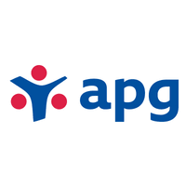



A Blended Finance Approach to Fundraising
With an intent to structure the vehicle to respond to the pipeline of transactions including in emerging markets
Experience in deal sourcing and
transaction management
The pipeline for the facility in all regions is strong. In Q1 2026 a market search will be conducted to update the pipeline to include most recent opportunities.
The team has extensive experience in originating, structuring and managing deals in developed and developing markets, including in Africa and Asia. All these deals have gone through a robust climate, ESG ,impact and risk assessment (positive and negative) which was signed off on by Boards, independent verifiers, ICs.
The team has the required and relevant experience in the targeted sectors and asset classes. Experience with asset management from strategy, business plan development, pipeline development, origination and execution of innovative transactions that set a new benchmark.
First tranche of seed capital secured: The Government of the Netherlands has committed its support to the Vehicle. Through Aqua for All it will provide EUR 250k funding to design the vehicle. The Government of Luxemburg will make a support statement at the WEF 2026 and has committed EUR 400-500k seed capital to set up the vehicle, disbursed in two tranches in 2026 – 2027. The WRC has initially committed for an amount of EUR 75k.
Investors in the vehicle: The first corporate has expressed willingness to invest USD 50 million in the vehicle by end 2026. As per the diagram in slide 6, corporate investments are expected to scale up rapidly.
Funders of the vehicle: The team has an extensive network in both developed and developing countries with a mix of potential financiers, including private investors, concessional donors, development partners and institutions and family offices.
Financial structuring capacity and demonstrated fundraising ability: The team has led on structuring successful funds and transactions that have mobilized significant private sector capital across developing markets, including, but not limited to:
Public funders:
Foundations:
Asset managers:
Private partners:
Funds:

Slide 55

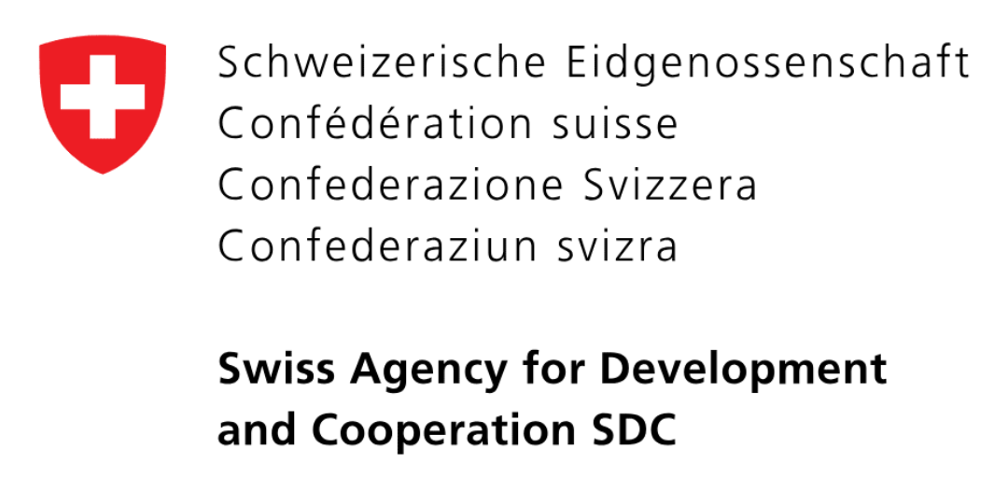
A blended finance approach to investing
Applied to the design of the Global Water Investment Facility
Definition:
Blended finance is the strategic use of public finance for the mobilisation of private finance towards sustainable development goals.
Blended Finance Providers
Corporate Water Investment Facility utilizes Blended Finance to invest across themes and sector opportunities
Facility level
Catalytic effect:
Shifts risk and return
Mobilizes capital
Lowers cost of capital
Fund level
Project level

Slide 56
Policies and Procedures Overview
Policy area – document - standard / alignment

Slide 57
Forecasts - Assumptions
Text
Text

Slide 58
Forecasts - Balance Sheet Development
Text
Text

Slide 59
Forecasts - Cash Flow & Investor Returns
Text
Text

Slide 60
Disclaimer
This document has been prepared solely for informational purposes to outline a potential trajectory for identifying investment opportunities and, at a later stage, selecting and structuring an appropriate investment vehicle. It does not constitute, and should not be construed as, an offer to sell or a solicitation of an offer to buy any securities in the United States, United Kingdom, the European Union or any other jurisdiction. Any such offer or solicitation will be made only through formal offering materials and in compliance with applicable securities laws.
This document may contain forward-looking statements regarding anticipated strategies, market opportunities, and potential outcomes. These statements are based on current assumptions and expectations and involve risks, uncertainties, and other factors that could cause actual results to differ materially. While the trajectory described reflects Aqua for All’s strategy and capabilities, its implementation and outcomes will depend on future conditions, assumptions (including market conditions), and other factors beyond the control of Aqua for All. Past performance is not indicative of future results. The information contained herein has been prepared by Aqua for All and is subject to revision, completion, and amendment.
Neither Aqua for All’s nor its directors, leads, managers, employees, or advisors make any representation or warranty, express or implied, as to the accuracy, completeness, or fairness of the information contained herein.
This presentation is confidential and may not be reproduced, distributed, or used for any purpose other than the evaluation of the information herein without the prior written consent of Aqua for All.
Join us
Johanna Westerdijkplein 1
2521 EN The Hague
The Netherlands
j.sluijs@aquaforall.org

